Slide 1
Modeling proteins only

Slide 2
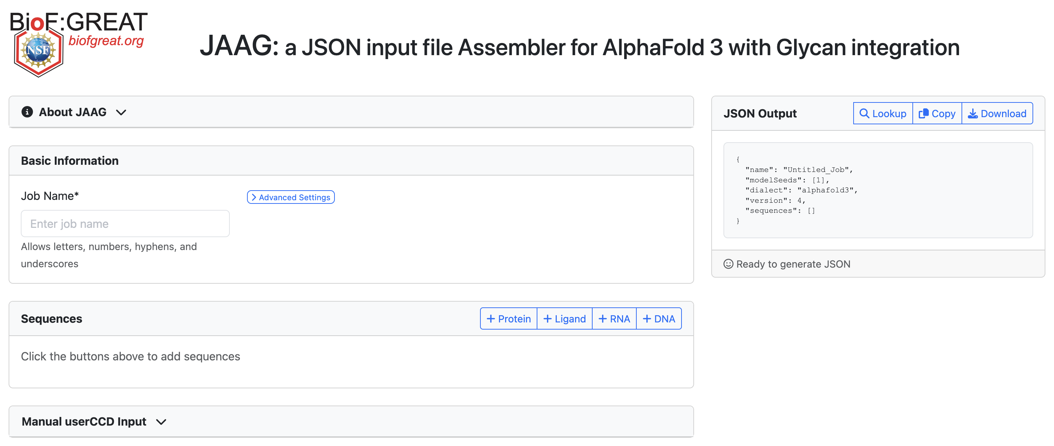
1
Type in job name
2
Add Protein
Notes:
1. Enter job name. Space and other special symbols are not allowed.
2. Click the button to add a protein. If users are interested in a second protein, click the button again.

Slide 3
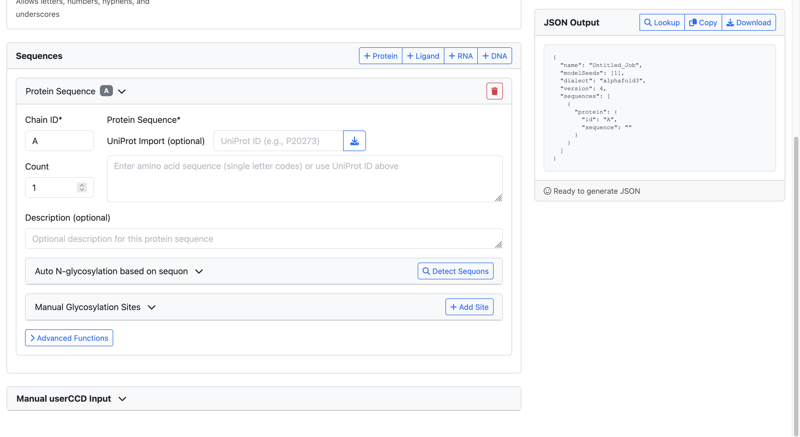
Download JSON file
5
3
Enter protein sequence
4
Toggle counts for multimers
Notes:
3. Type in the UniProt accession ID to fetch the protein sequence, or paste the amino sequence directly. Only when fetching from UniProt will JAAG automatically import the ID into the “Description” field below.
4. If users are looking into protein homo-multimers, toggle the count to the desire number.
5. Click the button to download the whole JSON file.

Slide 4
Modeling glycoproteins

Slide 5
1
Type in job name
2
Add Protein
Notes:
1. Enter job name. Space and other special symbols are not allowed.
2. Click the button to add a protein. If users are interested in a second protein, click the button again.

Slide 6
7
Import GlyTouCan and GlyGen ID
8
Download JSON file
3
Enter protein sequence
4
Toggle counts for multimers
5
Detect sequons for N-glycans
6
Manually add glycosylation sites
Notes:
3. Type in the UniProt accession ID to fetch the protein sequence, or paste the amino sequence directly. Only when fetching by UniProt will JAAG automatically import the ID into the “description” field below.
4. If users are looking into protein homo-multimers, toggle the count to the desire number.
5. Click the button to automatically add N-glycosylation sites based on sequons. Please see the following pages for more details.
6. Click the button to manually add any glycosylation sites. Please see the following pages for more details.
7. Click the button to look up glycan structure in the GlyTouCan and GlyGen database and import the corresponding glycan into the JSON file. The IDs will be placed in the corresponding description field.
8. Click the button to download the whole JSON file.

Slide 7
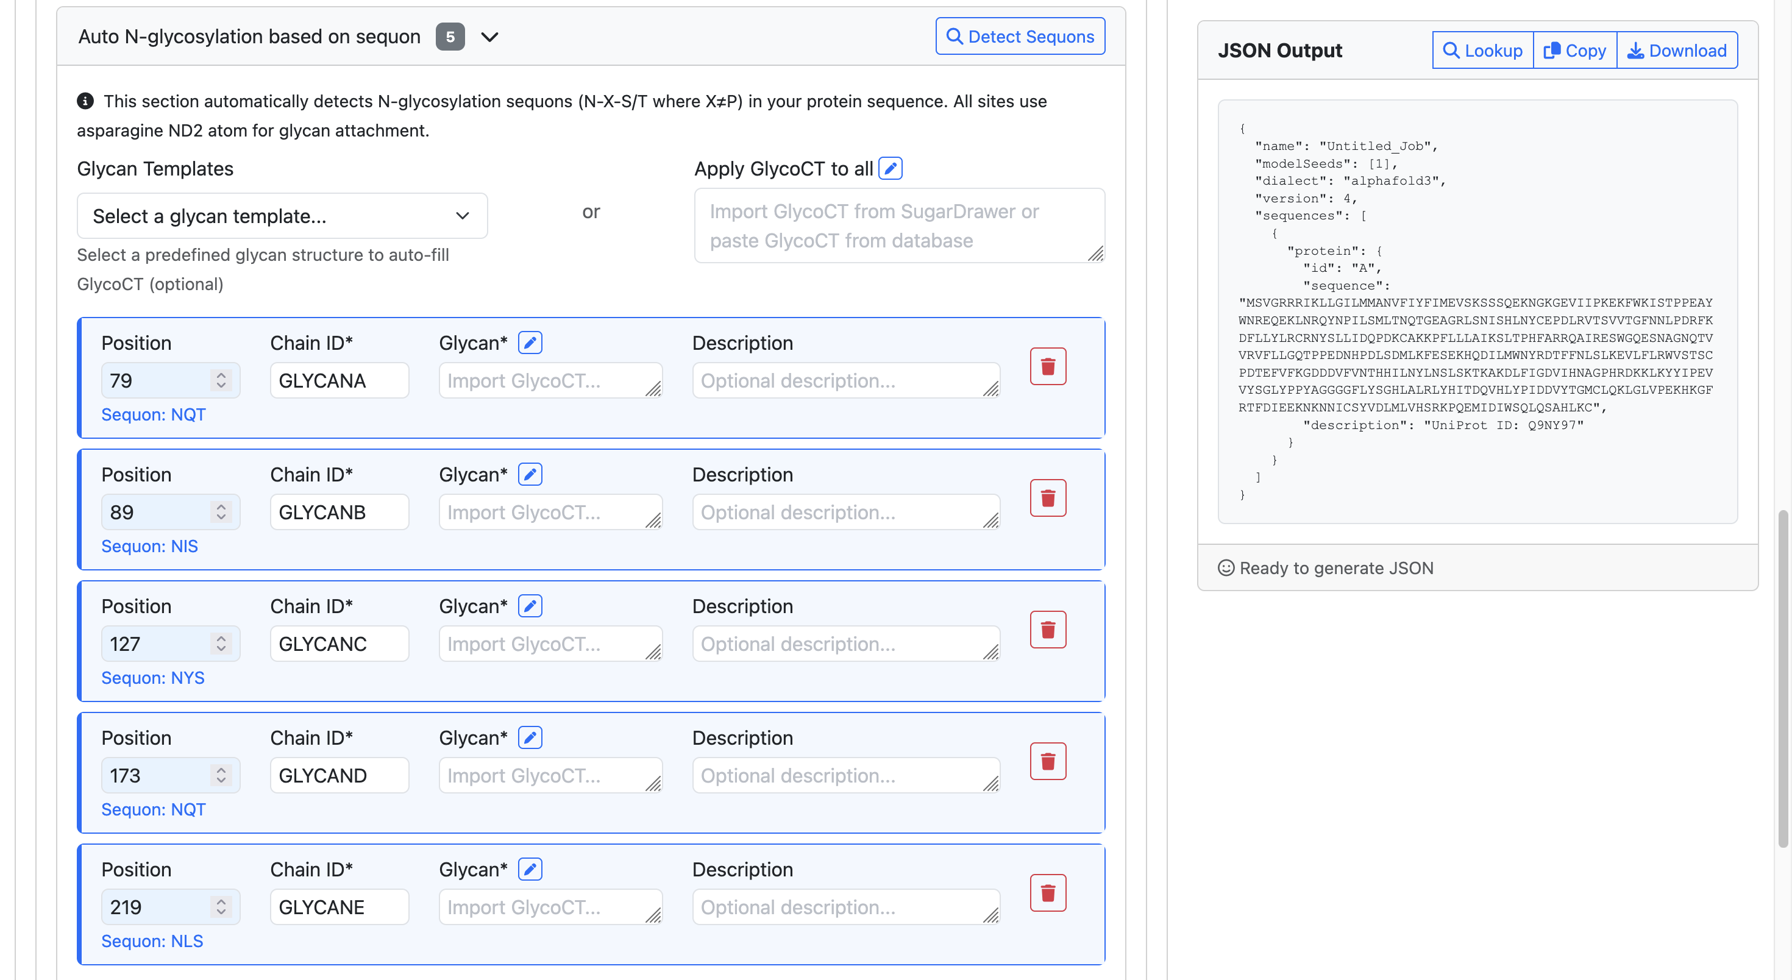
5.0
5.1
Add glycan templates to all N-glycan sites
Detect sequons for N-glycans
5.2
Add glycans from GlycoCT or SugarDrawer to all N-glycan sites
5.3
Add glycans from GlycoCT or SugarDrawer to single N-glycan sites
Notes:
5.0. This tab will be added and expanded after clicking the “Detect Sequons” button.
Glycan structures can be introduced using the following three methods: 5.1, 5.2 and 5.3. Users can first use 5.1 or 5.2 to apply the same glycan to all N-glycan sites, then modify each site individually in 5.3.
5.1. Select glycan structures from a library of pre-built N-glycan templates. Please see the following pages for more details.
5.2. Paste in GlycoCT from your favorite glycoinformatics database or click the pencil icon to open the pop-up SugarDrawer tool to draw glycans. This will apply to all N-glycosylation sites. Please see the following pages for more details.
5.3. Paste in GlycoCT from your favorite glycoinformatics database or click the pencil icon to open the pop-up SugarDrawer tool to draw glycans. This will apply to individual N-glycosylation sites. Please see the following pages for more details.

Slide 8
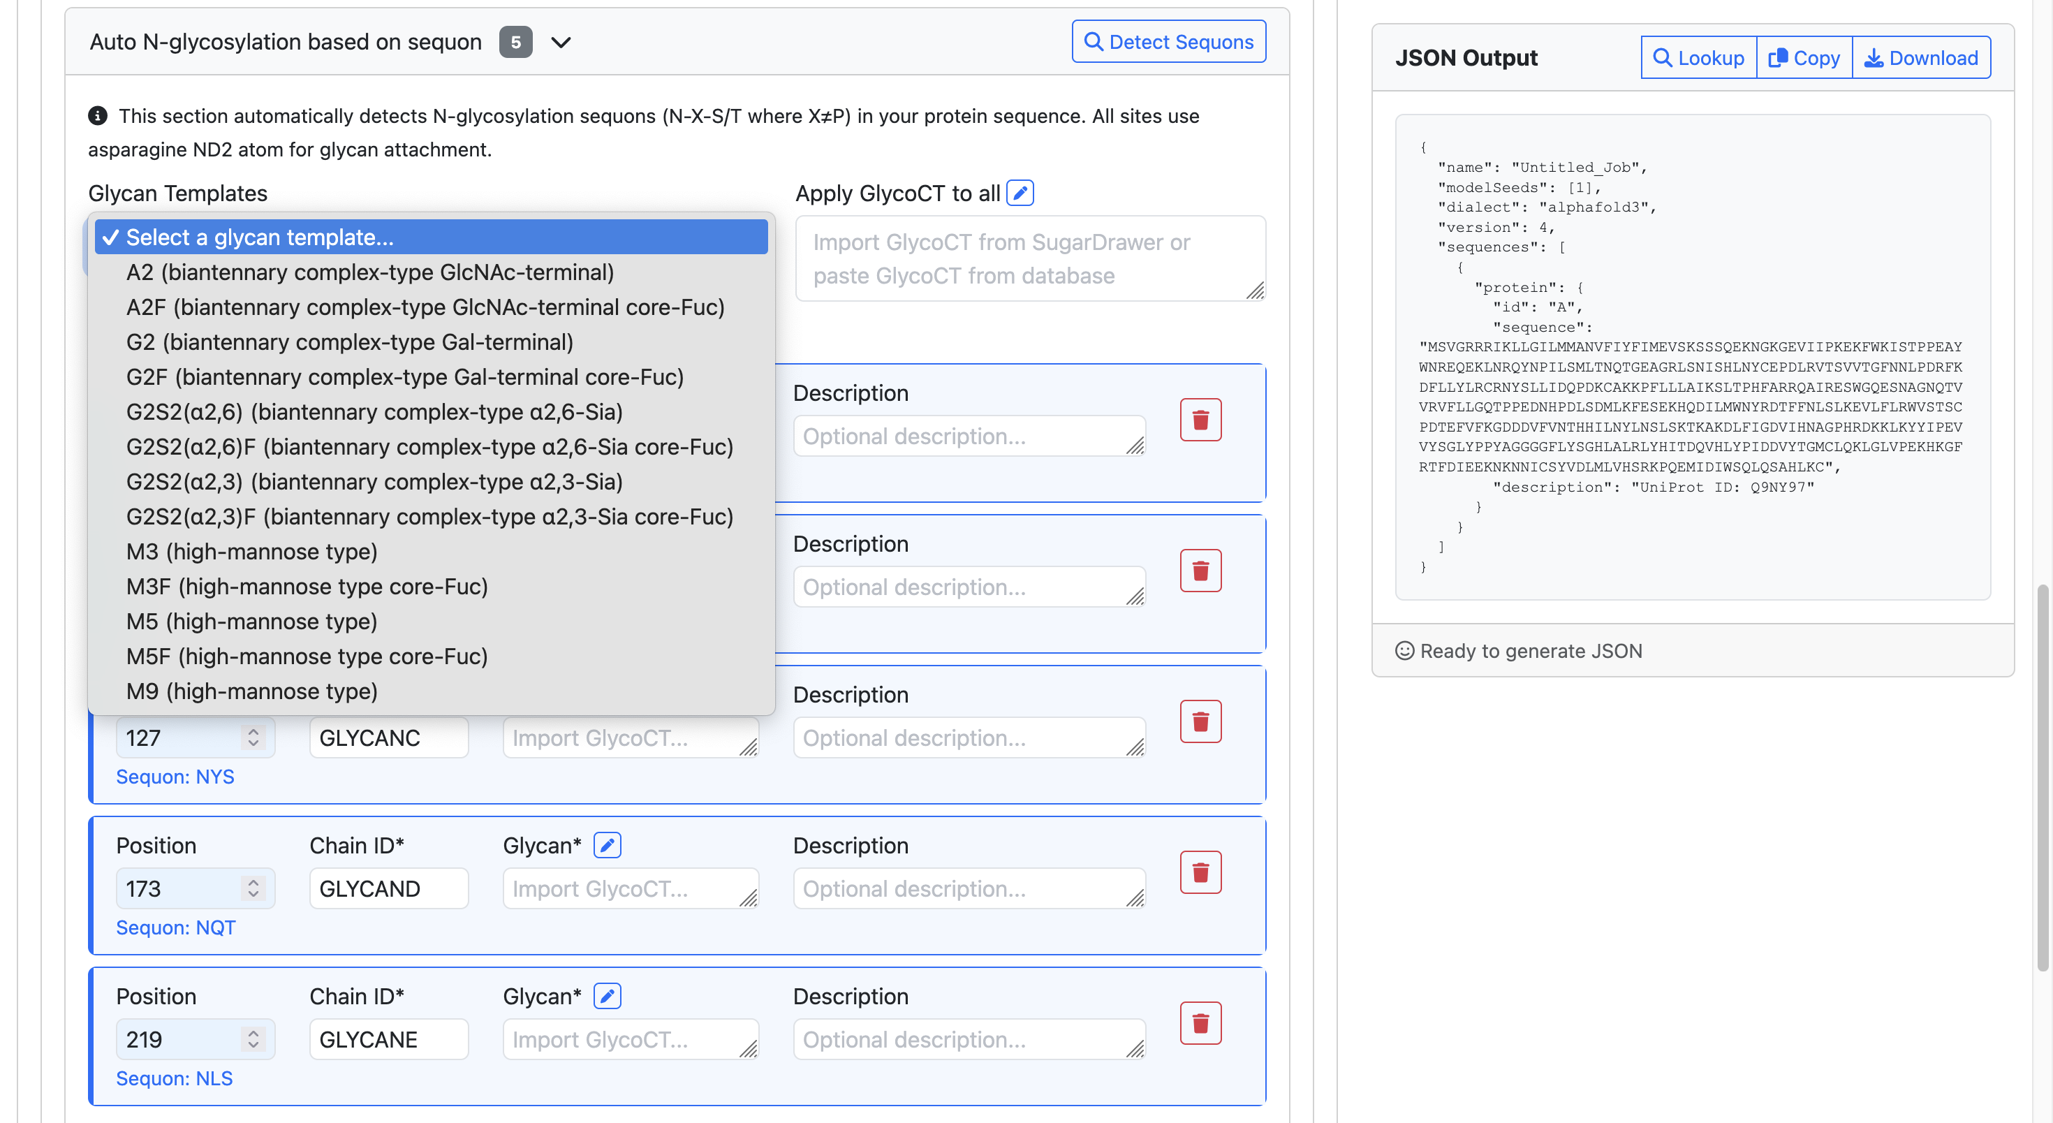
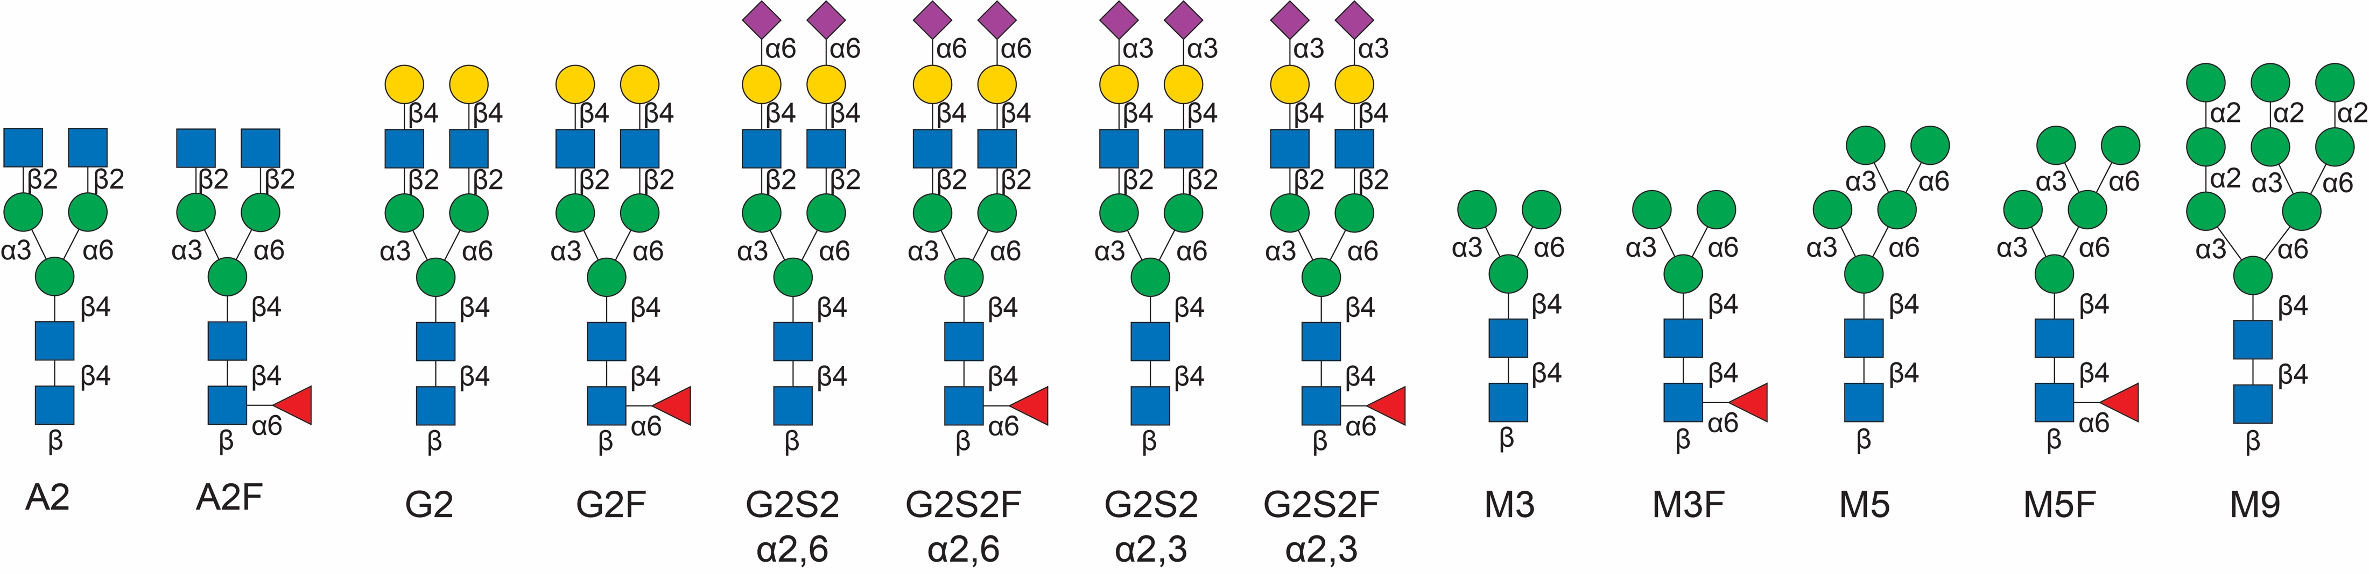
5.1.0
Add glycan templates to all N-glycan sites
5.1.1
Keys:
Notes:
5.1.0. This pull-down menu will appear after clicking “Select a glycan template…”
5.1.1. Select one glycan from the template collection to apply it to all N-glycosylation sites. The nomenclature key for each glycan abbreviation is provided.

Slide 9
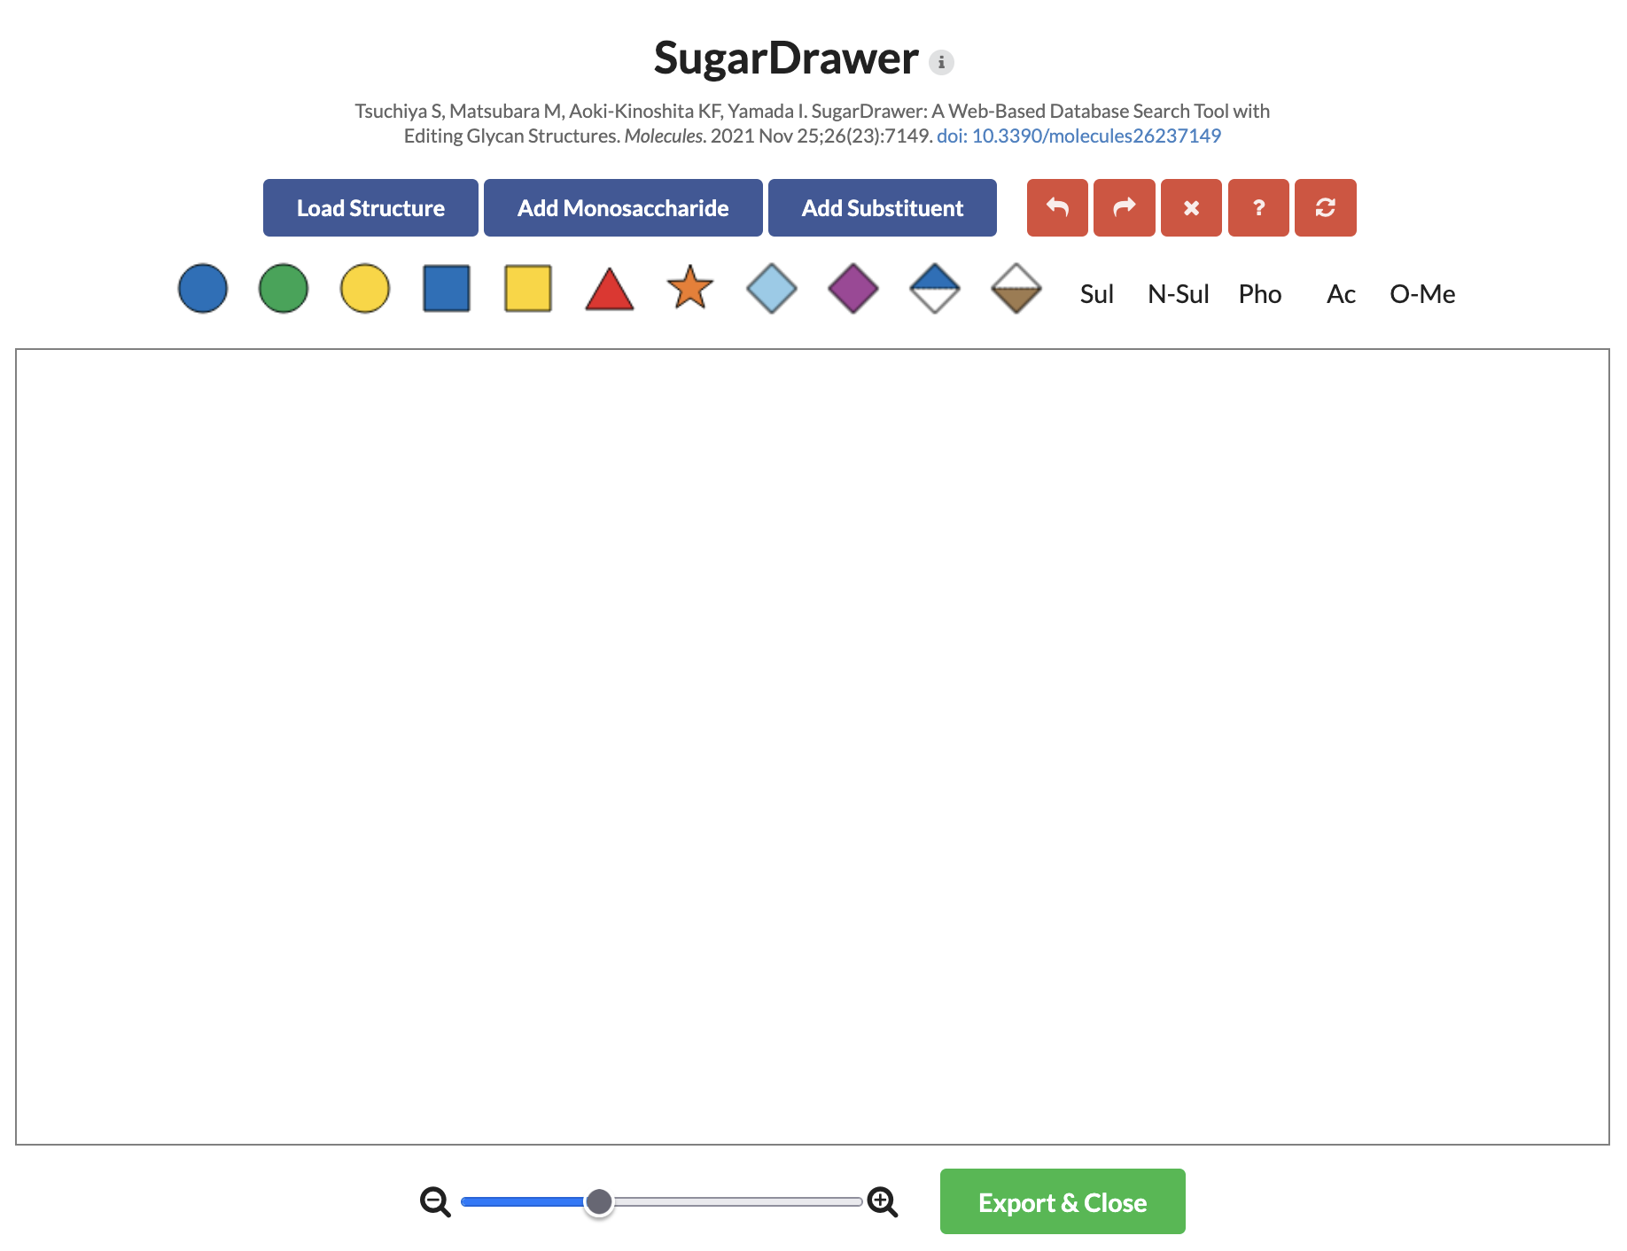
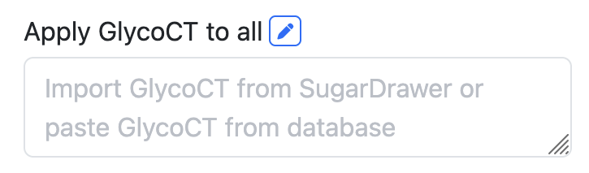
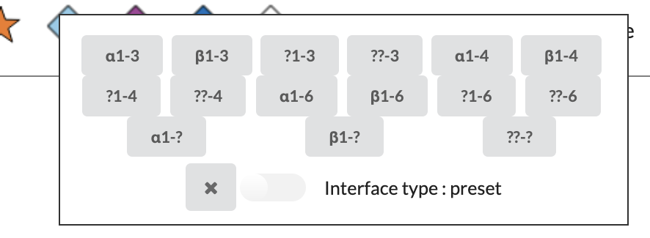
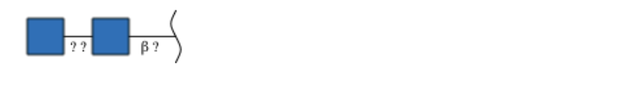
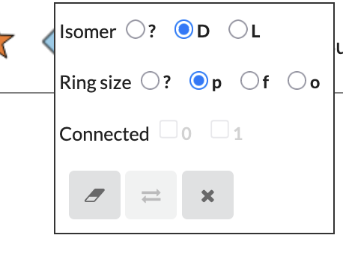
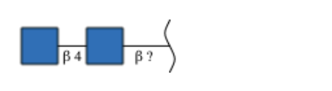
5.2.1
Click pencil to pop up SugarDrawer
5.2.2
Start drawing with templates
5.2.4
Add substituents
5.2.3
Add monosaccharides
5.2.3.1
Select linkage and anomer
5.2.5
Finish drawing
5.2.3.2
Right click for isomer and ring
This tutorial works for 5.3 as well
Notes:
5.2.1. Click the pencil icon to pop up SugarDrawer.
5.2.2. In the SugarDrawer, there are pre-built glycan templates that users can load to start the drawing the glycan structure. In the case here, find the N-glycan structures to start with.
5.2.3. Click the monosaccharides in the shortcut to extend glycans. If the monosaccharides are not in the shortcut, click the “Add Monosaccharide” button to expand the monosaccharide table.
5.2.3.1. Click the linkage line at the reducing end or between monosaccharides to pop up the anomer/linkage selection panel. Anomer and linkages must be defined to properly export the glycan bondedAtomPairs.
5.2.3.2. Right click the monosaccharide to pop up the isomer panel if users are using rare monosaccharides.
*Note: not all monosaccharides have corresponding CCD IDs.
5.2.4. Sul (sulfation), N-Sul (N-sulfation), Pho (phosphorylation), Ac (acetylation) and O-Me (methylation) are supported for bondedAtomPairs generation.
5.2.5. Click the button to export GlycoCT. The glycan bondedAtomPairs will be converted automatically.
This tutorial works for 5.3 as well to customize individual N-glycosylation sites.

Slide 10
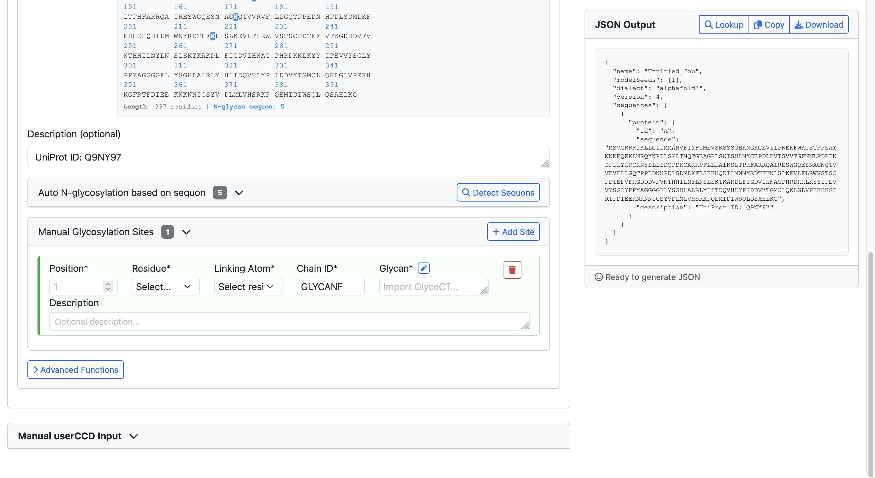
6.0
6.1
Enter amino acid number
Add glycosylation site
6.3
See 5.2 for using SugarDrawer
6.2
Select residue. If it’s not N/S/T, enter the atom linking to glycan
Notes:
6.0. This tab will be added and expanded after clicking “Add Site” button.
6.1. Users can type in amino acid numbers or toggle through the numbers.
6.2. When N/S/T are selected in 6.1, the amino acid atom linked to N- or O-glycan will appear automatically. If users are looking for other amino acid/atoms for glycosylation, look up PDBeChem for the atom: https://www.ebi.ac.uk/pdbe-srv/pdbechem/
6.3. Please refer to 5.2 for using SugarDrawer.

Slide 11
Modeling glycan as ligand
Referring to “modeling proteins only” or “modeling glycoproteins” sections to add protein

Slide 12
1
Type in job name
2
Add Ligand
Notes:
1. Enter job name. Space and other special symbols are not allowed.
2. Click the button to add a ligand. If users are interested in a second ligand, click the button again.

Slide 13
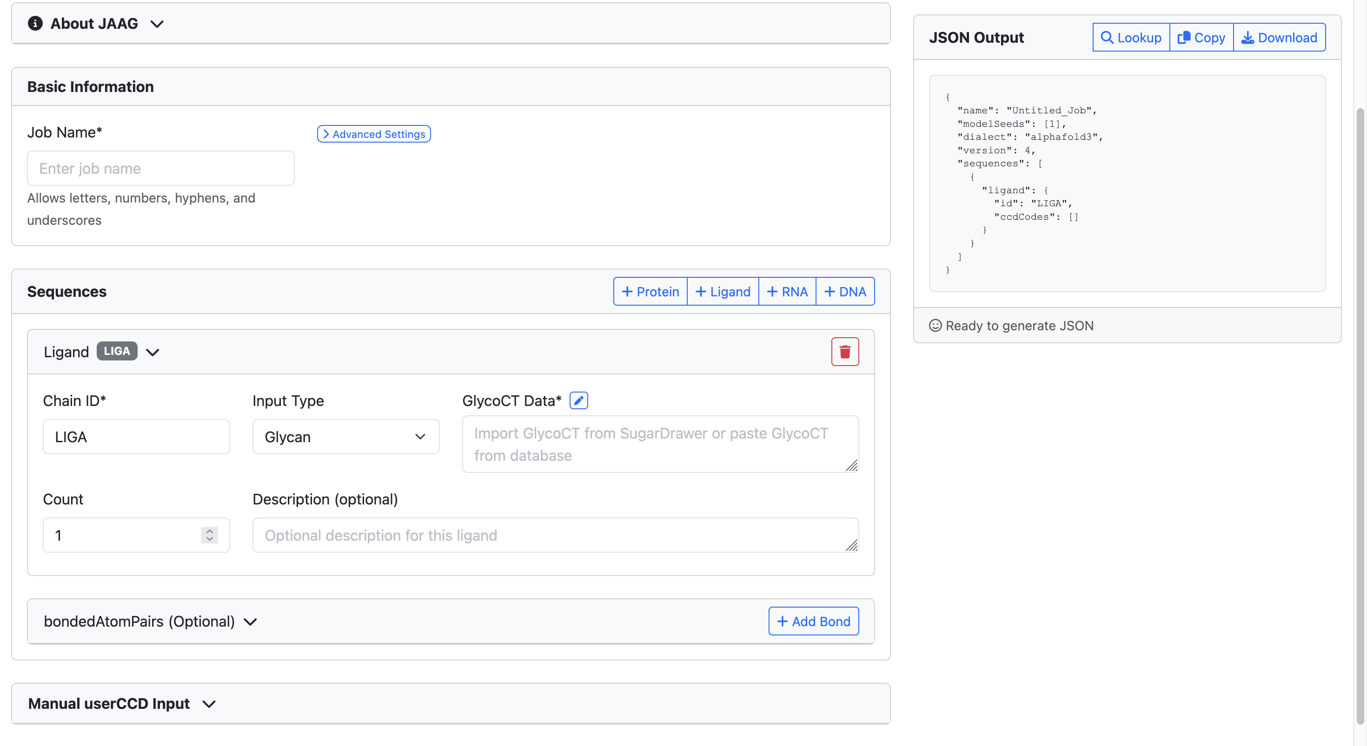
4
Import GlyTouCan and GlyGen ID
5
Download JSON file
3
Add glycans from GlycoCT or SugarDrawer
Notes:
3. Paste in GlycoCT ID from your favorite glycoinformatics database or click the pencil icon to pop up SugarDrawer to draw glycans. Please see the following pages for more details.
4. Click the button to to look up glycan structures in GlyTouCan and GlyGen databases to import the corresponding glycan ID into the JSON file. The ID will be attached into the corresponding description field.
5. Click the button to download the whole JSON file.

Slide 14
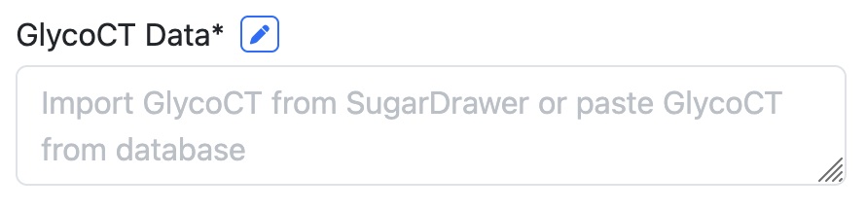
3.1
Click pencil to pop up SugarDrawer
3.2
Start drawing with templates
3.4
Add substituents
3.3
Add monosaccharides
3.3.1
Select linkage and anomer
3.5
Finish drawing
3.3.2
Right click for isomer and ring
Notes:
3.1. Click the pencil icon to pop up SugarDrawer.
3.2. In the SugarDrawer, there are pre-built glycan templates that users can load them to start the glycan drawing process.
3.3. Click the monosaccharides in the shortcut menu bar above to extend the glycan structure. If the monosaccharides are not in the shortcut, click the “Add Monosaccharide” button to expand the monosaccharide table.
3.3.1. Click the linkage line at the reducing end or between monosaccharides to pop up the anomer/linkage selection panel. Anomer and linkages must be defined to properly export the glycan bondedAtomPairs.
3.3.2. Right click the monosaccharide to pop up the isomer panel if users are using rare monosaccharides.
3.4. Sul (sulfation), N-Sul (N-sulfation), Pho (phosphorylation), Ac (acetylation) and O-Me (methylation) are the substituents that are supported for bondedAtomPairs generation.
3.5. Click the button to export GlycoCT. The glycan bondedAtomPairs will be converted automatically.

Slide 15
Example of building B3GNT2 homodimer-Mn²⁺-UDP-GlcNAc-LNnT complex

Slide 16
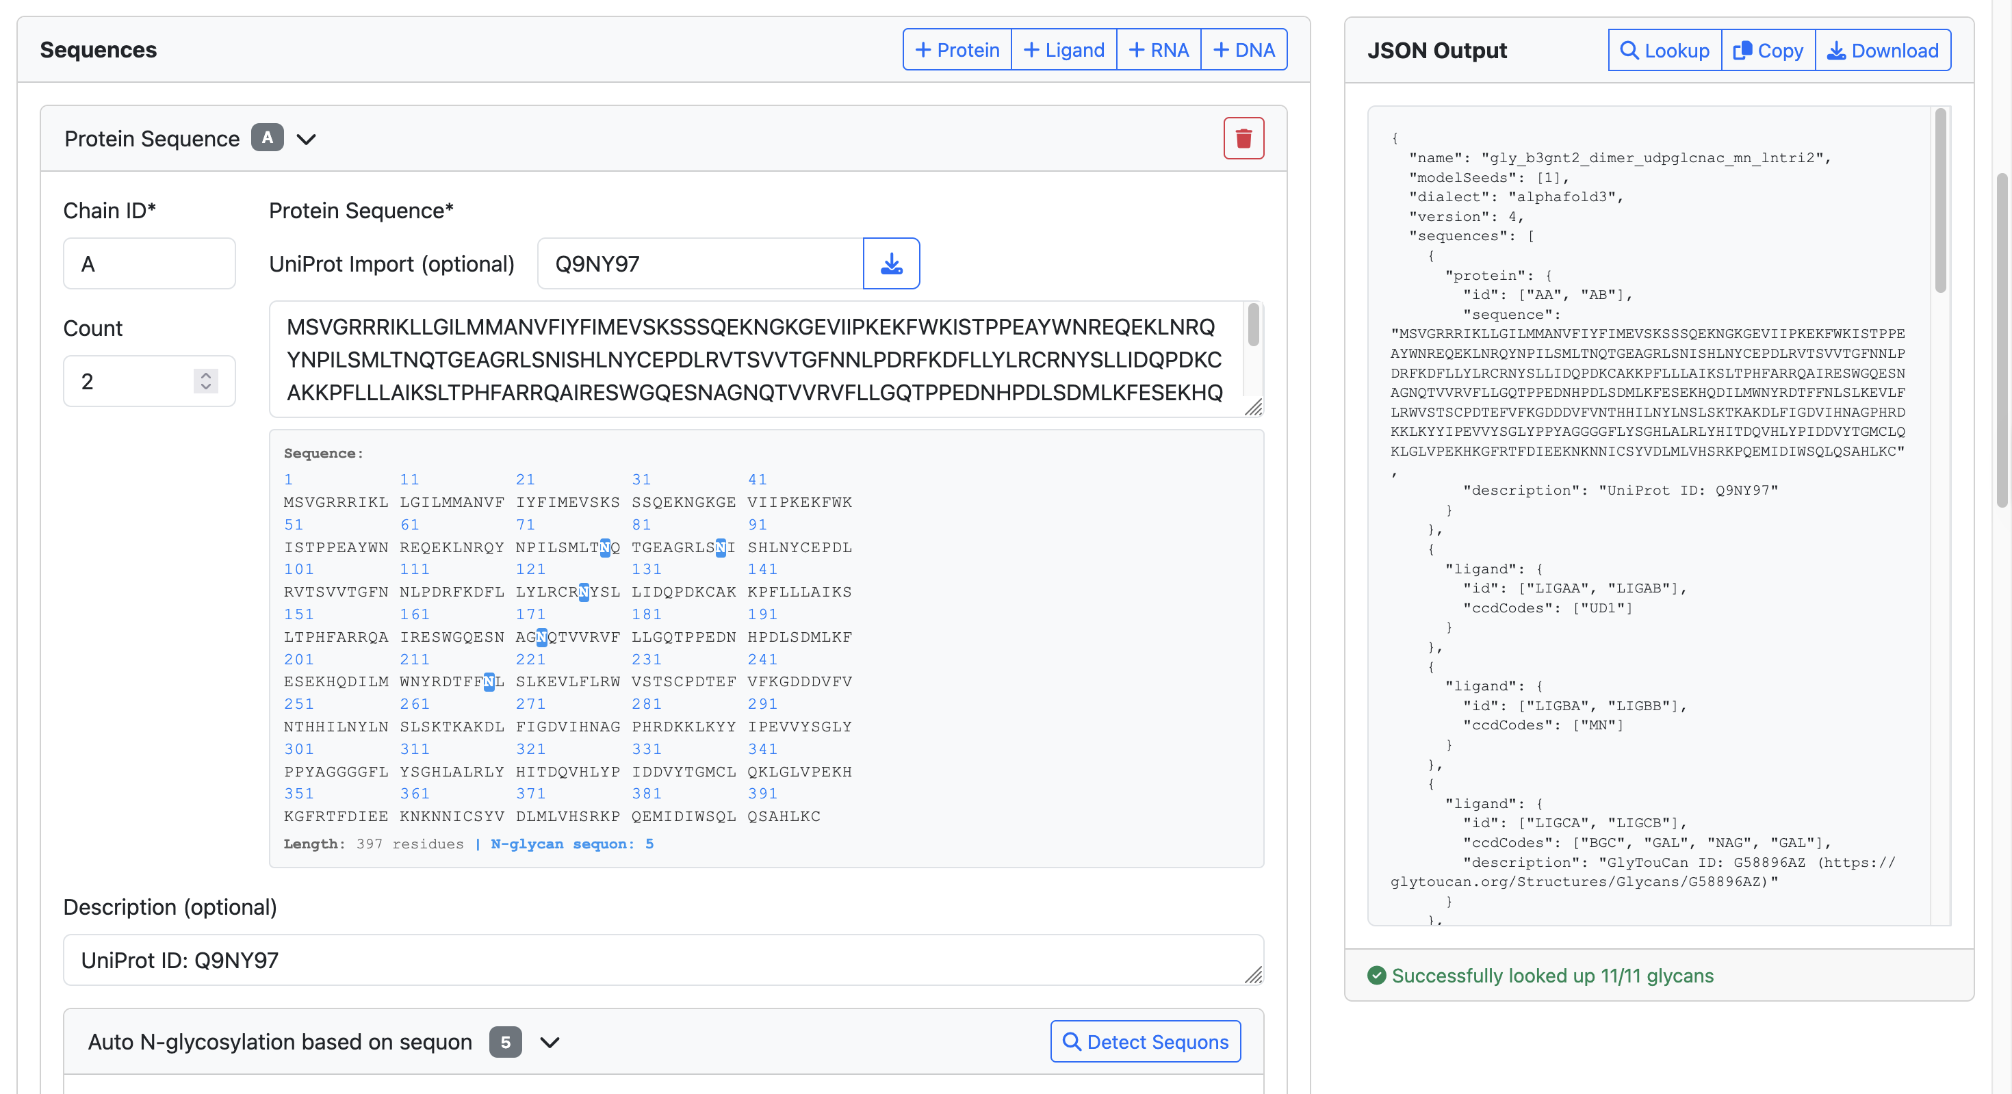
1
Add protein
Fetch the amino sequence from UniProt accession ID
2
Toggle count to 2 for modeling two copies of B3GNT2
3
Scroll down the page looking for “Detect Sequon” button
4

Slide 17
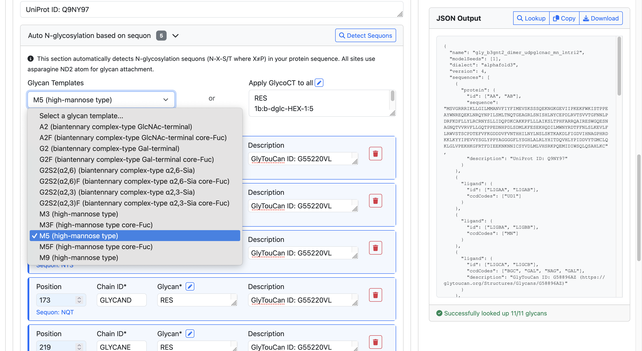
5
Detect sequons for N-glycans
6
Add glycan templates to all N-glycan sites
Scroll down the page and inspect if every site is reasonable
8
7
Select M5 in this example

Slide 18
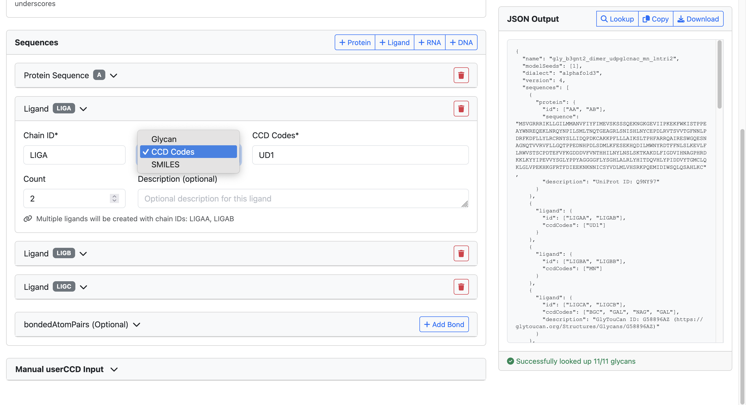
9
Add the first ligand
10
Select CCD
11
Add UDP-GlcNAc CCD code
12
Toggle count to two

Slide 19
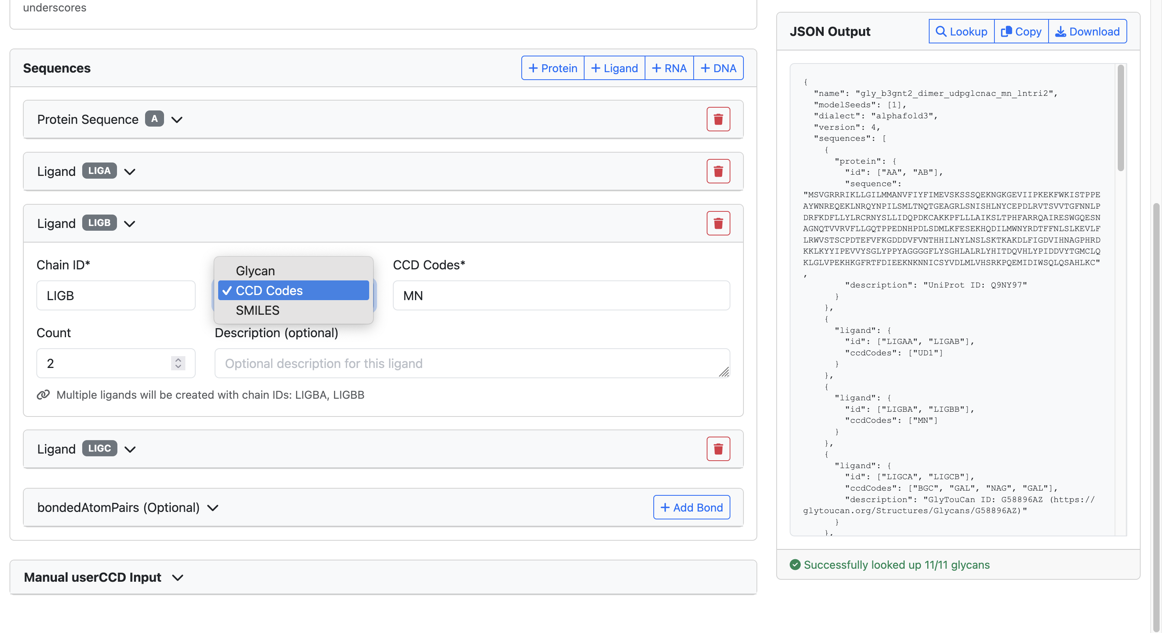
13
Add the second ligand
14
Select CCD
15
Add magnesium CCD code
16
Toggle count to two

Slide 20
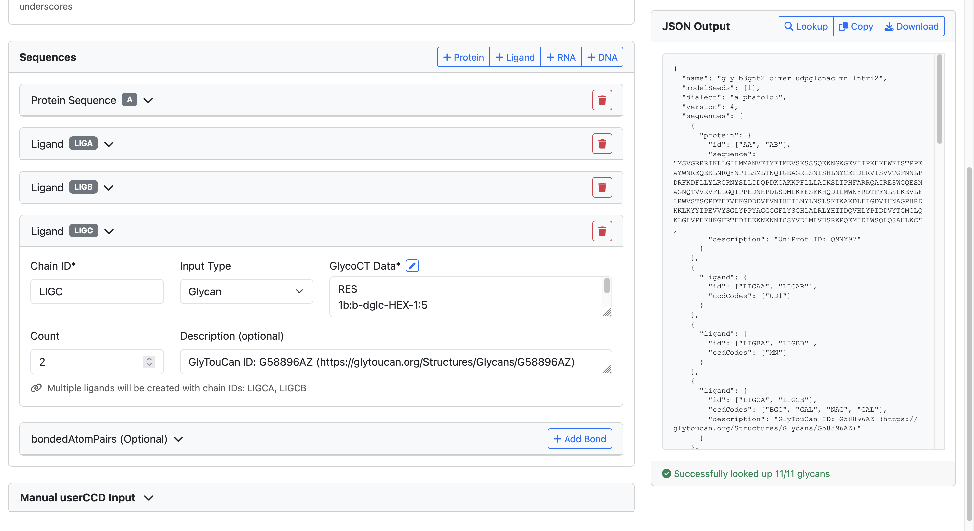
21
17
Add the third ligand
Download JSON file
Paste the LNnT GlycoCT or draw from SugarDrawer by clicking the pencil icon
18
20
Look up GlyTouCan and GlyGen ID by clicking “Lookup” button
19
Toggle count to two

